Slide 1
Big Data Processing

Slide 2
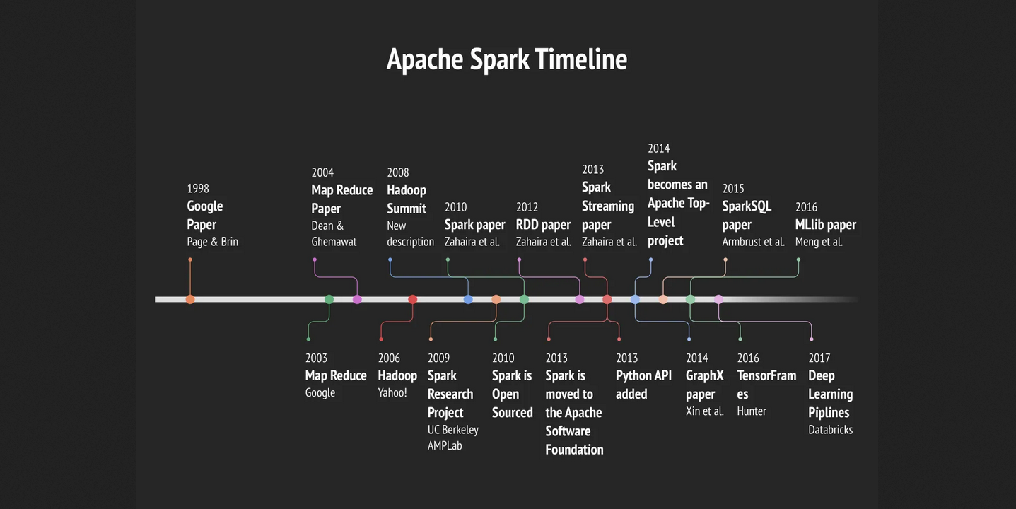

Slide 3
Map Reduce

Slide 4
What is Map and Reduce ?
MapReduce
Parallel programming paradigm which allows for processing of huge amounts of data by running processes on multiple machines.
Defining a MapReduce job requires two stages: map and reduce.
Map:
operation to be performed in parallel on small portions of the dataset. the output is a keyvalue pair < K, V >
Reduce:
operation to combine the results of Map

Slide 5
What is Map and Reduce ?
Word Count
Output
Input
Apple Alpha Beta Bat Cat Charlie Apple Alpha Beta Cat Charlie Alpha Apple Beta
Bat Cat Cat
Apple 3
Alpha 3
Beta 3
Bat 2
Cat 3
Charlie 2

Slide 6
What is Map and Reduce ?
Reduce
Map
Apple1
Apple1
Apple1
Input
Apple1
Alpha1
Beta1
Bat1
Cat1
Output
Alpha1
Alpha1
Alpha1
Apple Alpha Beta Bat Cat Charlie Apple Alpha Beta Cat Charlie Alpha Apple Beta
Bat Cat Cat
Charlie1
Apple1
Alpha1
Beta1
Cat1
Apple 3
Alpha 3
Beta 3
Bat 2
Cat 3
Charlie 2
Beta1
Beta1
Beta1
Beta1
Beta1
Beta1
Charlie1
Alpha1
Apple1
Beta1
Bat1
Bat1
Bat1
Cat2
Cat1
Cat1
Charlie1
Charlie1

Slide 7
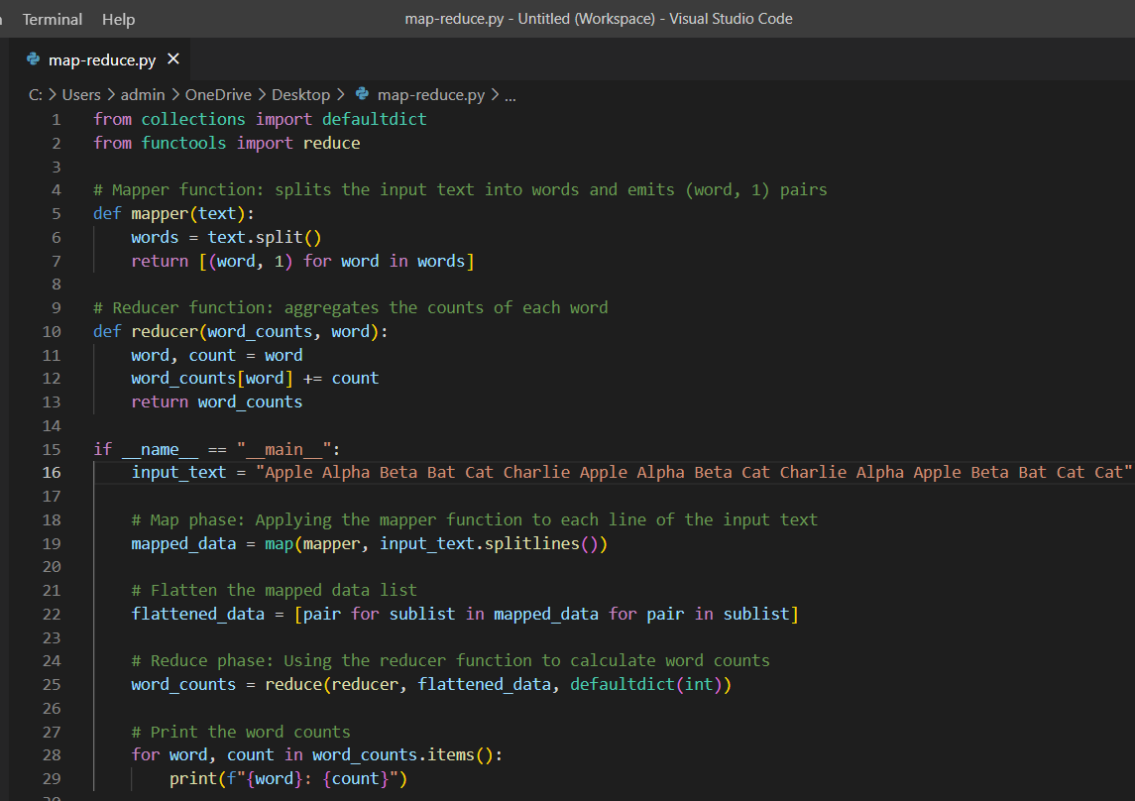

Slide 8
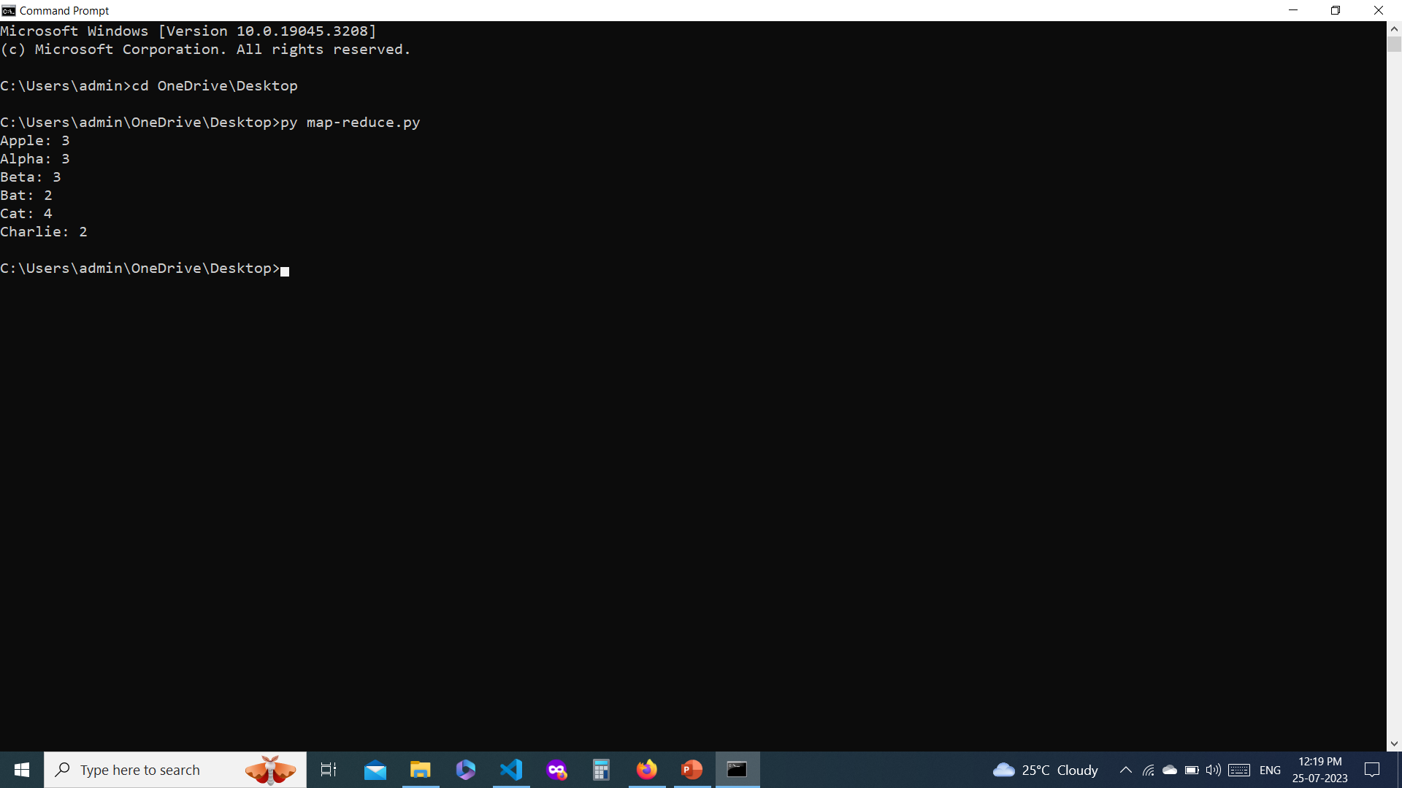

Slide 9
Apache Hadoop

Slide 10

What is Apache Hadoop?
OpenSource Framework
Hadoop Ecosystem
Distributed Storage
MapReduce
Batch Processing
Highly Scalable
Fault Tolerance
Data Variety
Data Processing

Slide 11
Apache Hadoop Architecture

Slide 12
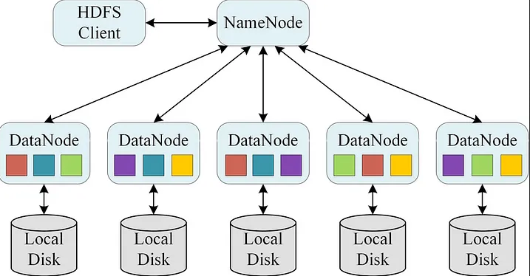
Apache Hadoop Architecture
Source: Research Gate

Slide 13
Apache Hadoop Ecosystem
STORAGE:
Distributed Storage (HDFS):
Hadoop offers Hadoop Distributed File System (HDFS) for distributed storage
Data is stored across multiple servers (nodes) for scalability and fault tolerance
Data is divided into blocks and replicated across nodes to ensure data reliability
PROCESSING
MapReduce Processing Model:
Hadoop employs the MapReduce programming model for distributed data processing
Complex tasks are broken down into smaller subtasks (mapping and reducing)
These tasks are distributed across the cluster for parallel execution
MapReduce abstracts the complexities of parallelism and fault tolerance, simplifying distributed computing

Slide 14
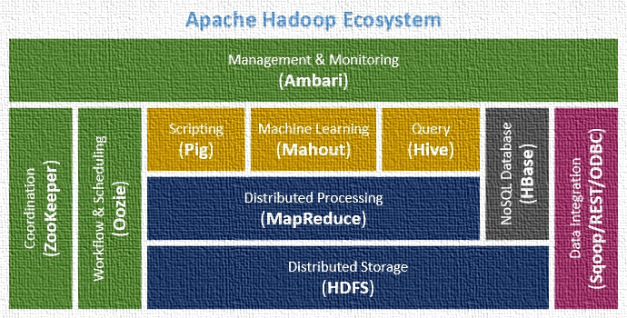
Apache Hadoop Ecosystem
Project includes these modules:
Hadoop Distributed File System (HDFS): A distributed file system that provides highthroughput access to application data.
HBase: A scalable, distributed database that supports structured data storage for large tables.
Hive: A data warehouse infrastructure that provides data summarization and ad hoc querying.
Pig: A highlevel dataflow language and execution framework for parallel computation.

Slide 15
Apache Hadoop Programming

Slide 16
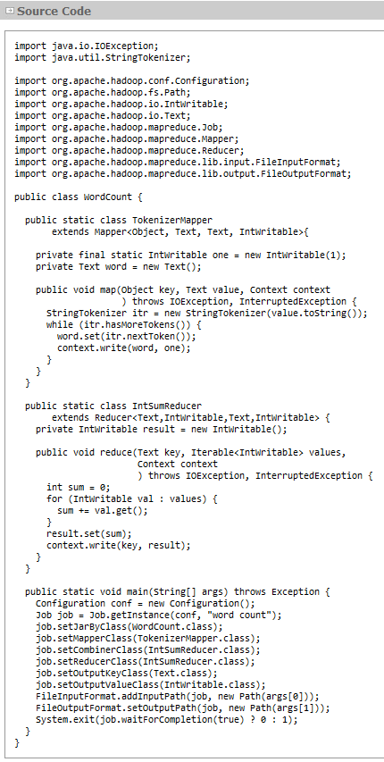
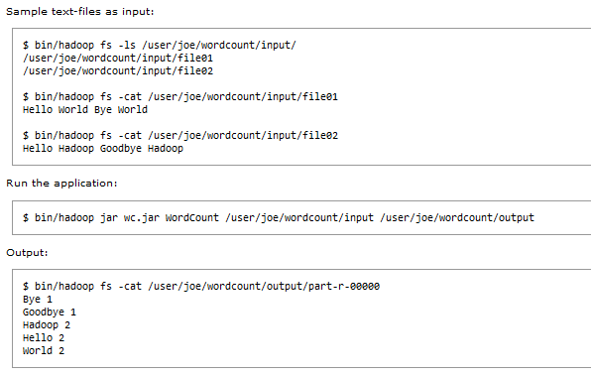
Hadoop Programming
https://hadoop.apache.org/docs/stable/hadoopmapreduceclient/hadoopmapreduceclientcore/MapReduceTutorial.html

Slide 17


Slide 18
What is Apache Spark?
Open Source: Apache Spark is an opensource, distributed computing framework for processing large datasets.
Speed: Spark is known for its speed and can process data much faster than traditional MapReduce.
InMemory Processing: It performs data processing in memory, reducing the need for costly disk I/O operations.
Distributed Data Processing: Spark divides data into partitions and processes them in parallel across a cluster of nodes
Diverse Workloads: batch processing, interactive queries, streaming, and machine learning within a unified framework.
Programming Languages: Supports multiple programming languages, including Scala, Java, Python, and R.
Spark Ecosystem: Includes libraries like Spark SQL, Spark Streaming, MLlib (Machine Learning
Streaming: Spark Streaming allows realtime data processing and integration with sources like Kafka
Machine Learning: MLlib provides machine learning algorithms and tools for predictive analytics
Compatibility: Can run on various cluster managers, including Apache Mesos, Hadoop YARN, and standalone clusters
Data Sources: Supports a wide range of data sources, including HDFS, Apache Cassandra, Apache HBase, and more

Slide 19
Apache Spark Architecture

Slide 20

Apache Spark Architecture

Slide 21
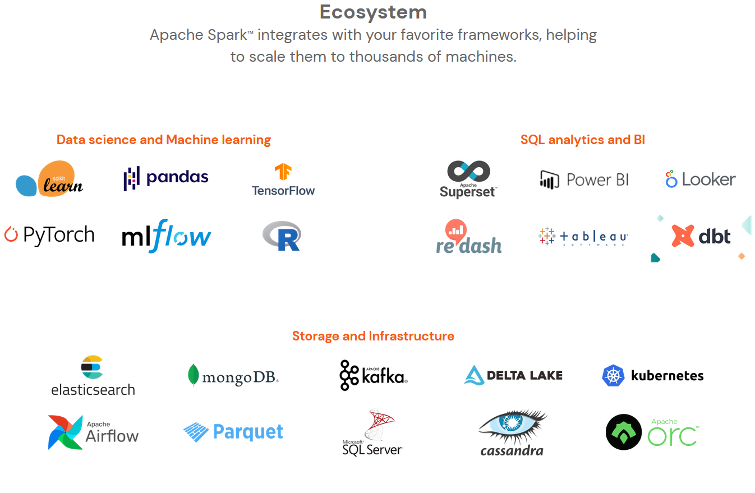
Spark EcoSystem
https://spark.apache.org/

